Slide 1
Conquering Supply Chain Management
Thomas Choi, Ph.D.
Harold E. Fearon Chair in Purchasing Management
Executive Director of CAPS Research
W. P. Carey School of Business
Arizona State University
February 2016

Slide 2

Conquering Supply Chain Management

Slide 3
Focus Studies Topics at CAPS Research
Supply Network Mapping and Identifying Critical Suppliers across the Supply Chains

Slide 4
Overview
Nexus suppliers as a new type of critical supplier
Case Study from Honda
  Mapping of a supply network
  Application of network analysis
Nexus Supplier Index (NSI)
  Theoretically
  In real world
Results and Observations
Other recent CAPS Research focus studies projects

Slide 5
Nexus Suppliers Defined
Critical suppliers due to their structural position in the network
  Exist anywhere in the network
  Show specific mathematical properties.
The buying firm:
  May not have a visual on them
  May not yet be aware of their criticality

Slide 6
Comparing a Strategic and Nexus Supplier
 | Strategic Supplier | Nexus Supplier
Tier in the supply network | Top-tier | Any tier
Visibility to the focal buying firm | Visible | Not necessarily visible
Profit impact | High and direct | Potentially high and indirect
Mutual dependence | High and direct | Potentially high and indirect
Ideal relationship with the focal buying firm | Close | Not necessarily close
Sources of value | Superior internal capabilities and resources | Unique positions in inter-organizational networks

Slide 7

Honda Study

Slide 8
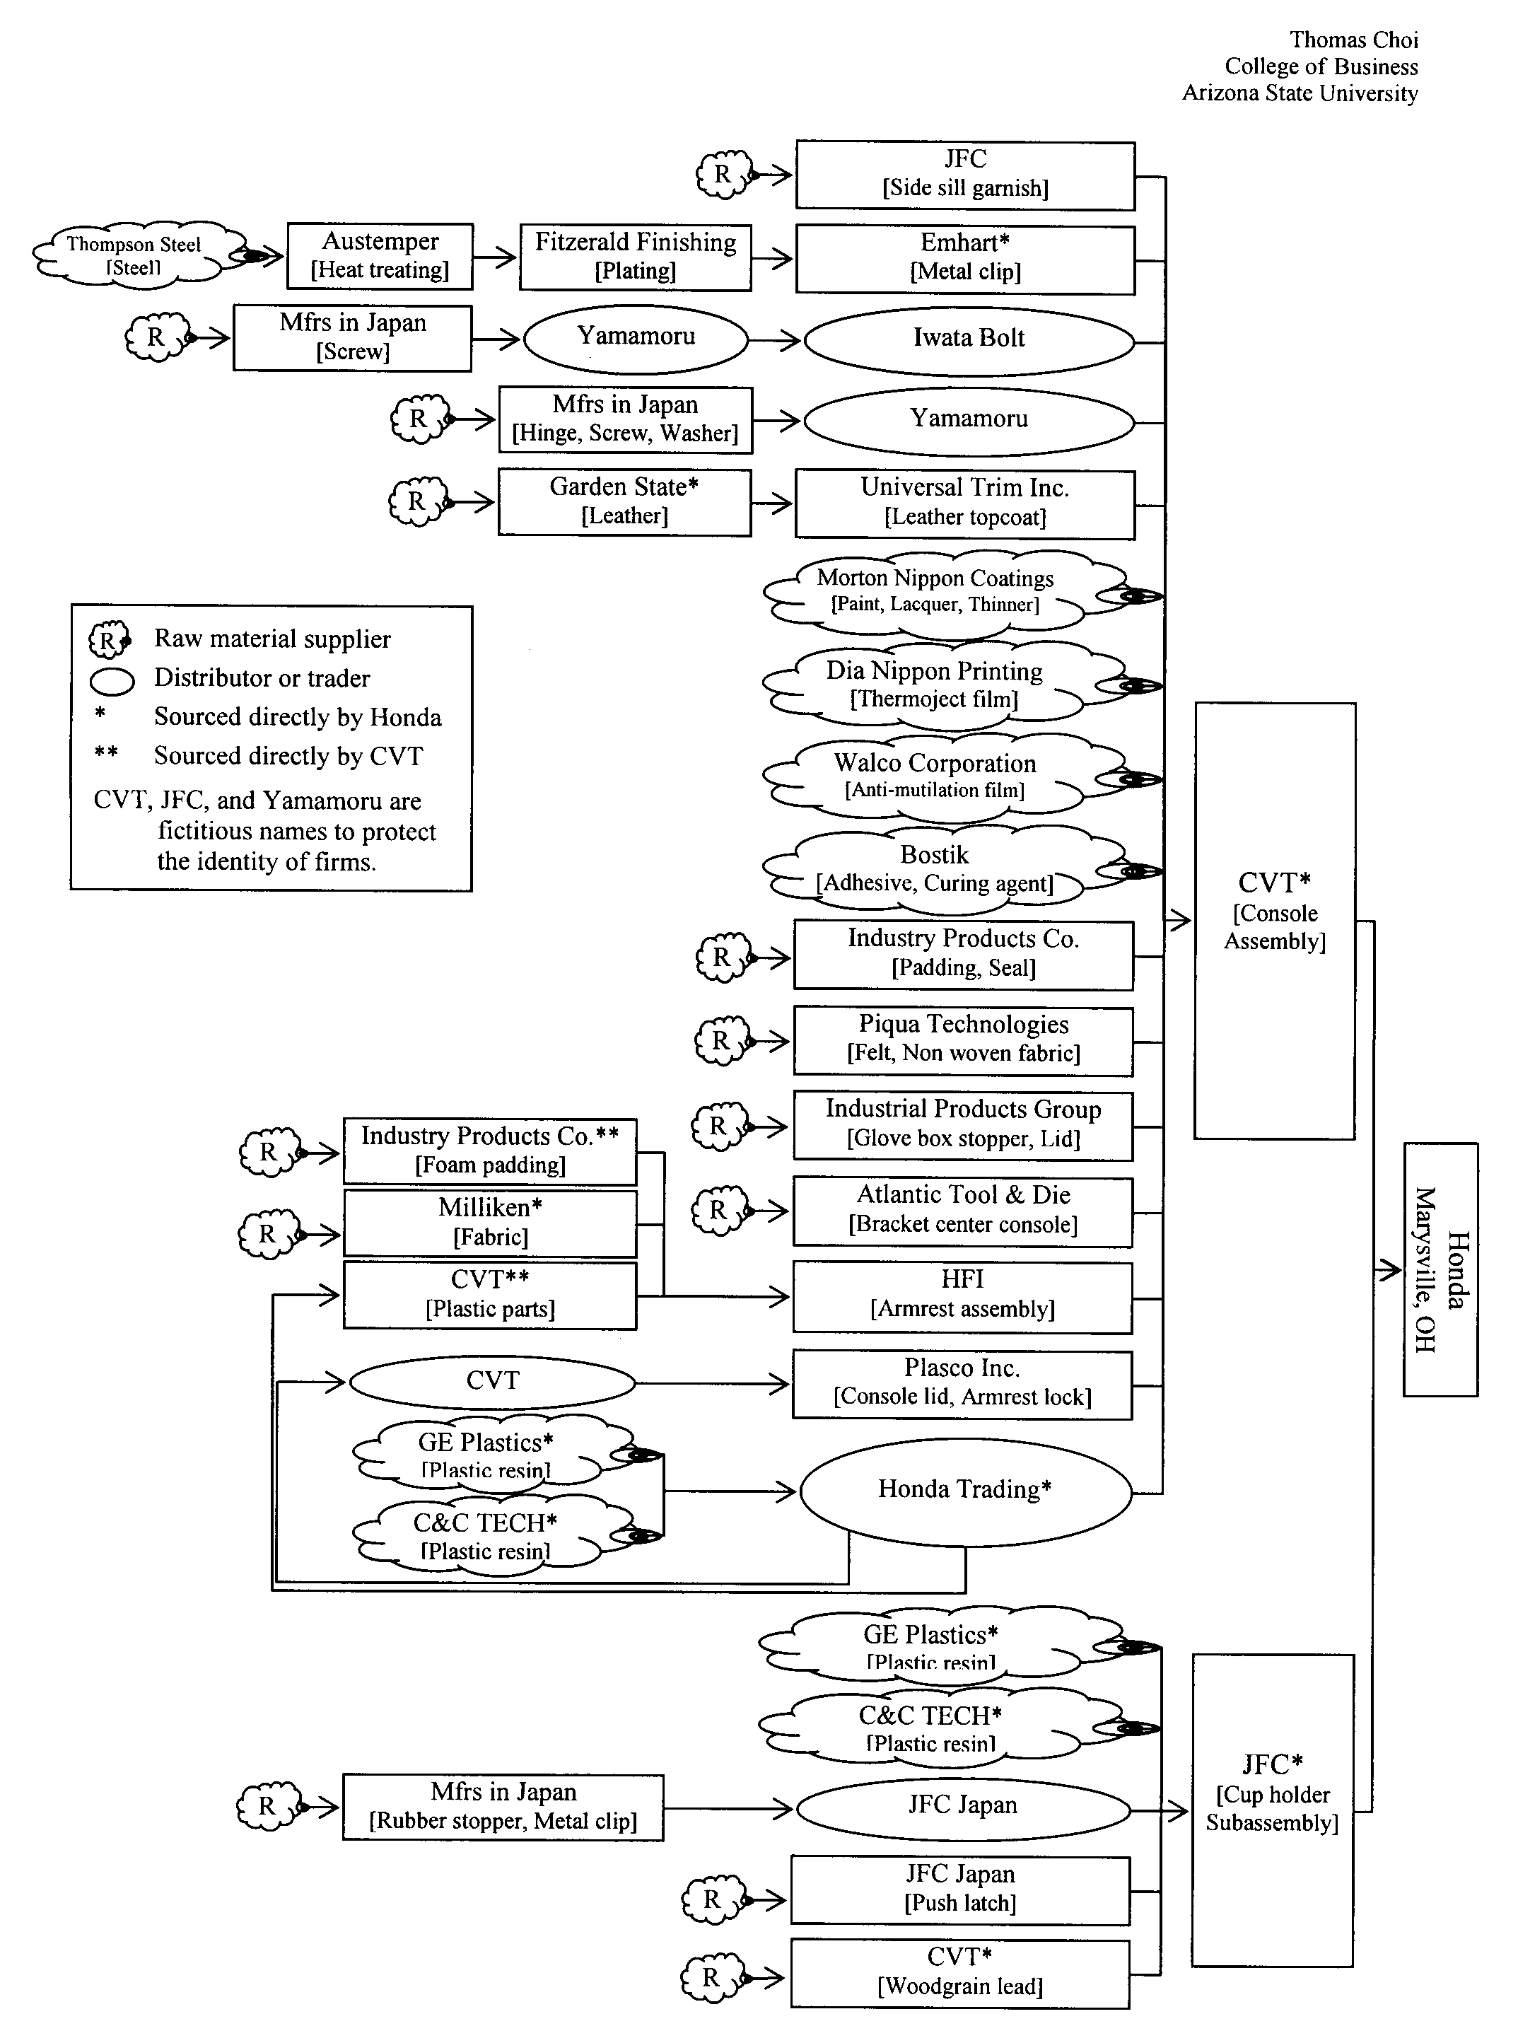
Honda Center Console Supply Map: A “Tree-Like” Structure

Slide 9
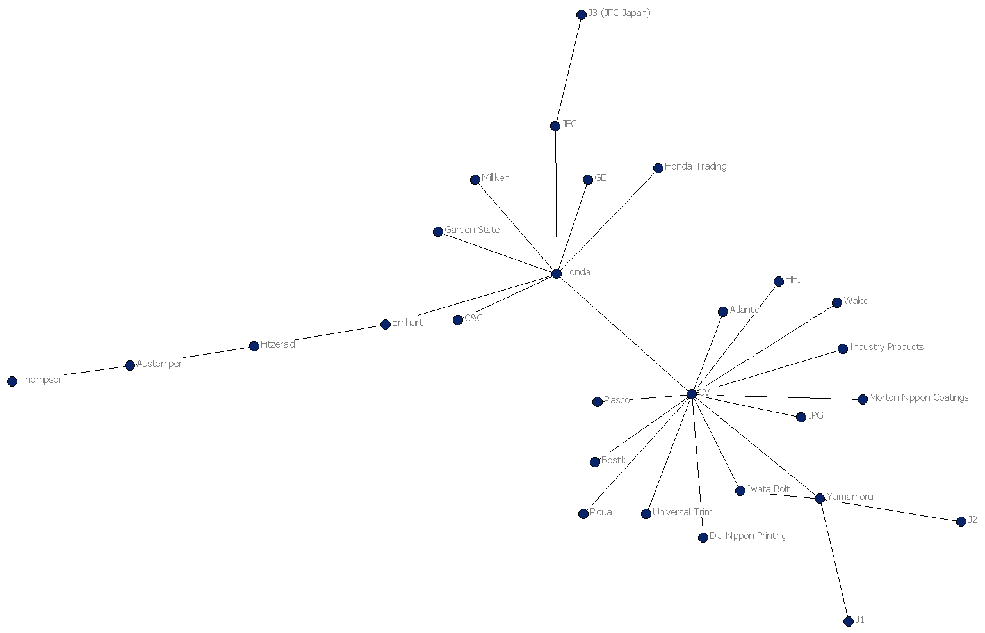
Contractual Relationship “Network”

Slide 10
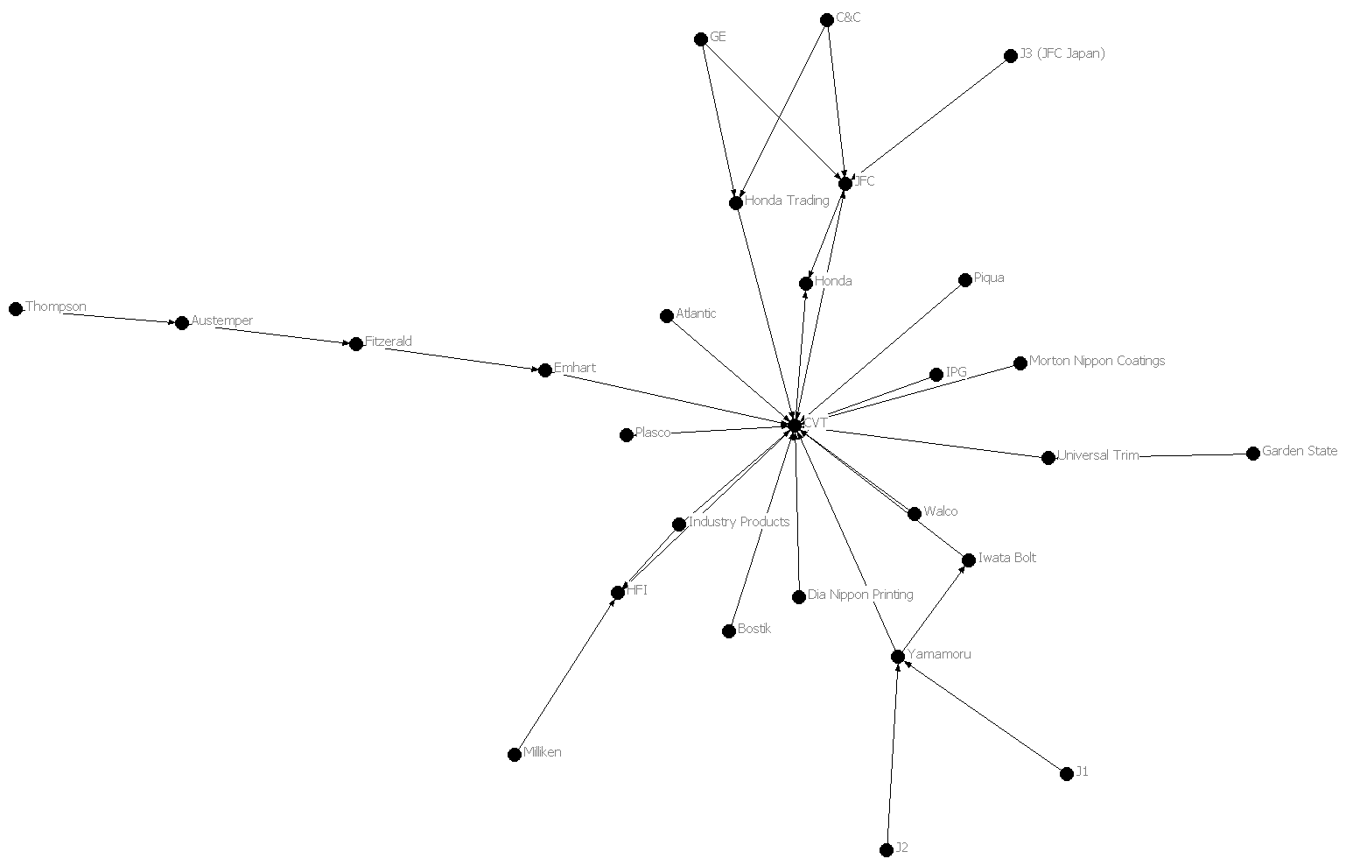
Materials Flow “Network”

Slide 11
List of key firms based on materials flow SN
Various Forms of “Centrality” Measures
List of key firms based on contractual relationships SN
Influential Scope¹ | Informational Independence² | Relational Mediation³
CVT (52), Honda (30), Yamamoru (15) | CVT (57), Honda (53), Yamamoru (40) | CVT (79), Honda (64), Emhart (21) Yamamoru (15), Fitzerald (14)
¹ Firms with degree > 15
² Firms with closeness > 40
³ Firms with betweenness > 10
Supply Load¹ | Demand Load² | Operational Criticality³
CVT (59⁴), JFC (15), HFI (11) | CVT (15), C&C (7.4), JFC (7.4), GE (7.4), Yamamoru (7.4), Industry Products (7.4) | CVT (13), Emhart (2), Yamamoru (1.7), Fitzerald (1.7), JFC (1.3)
¹ Firms with in-degree > 10
² Firms with out-degree > 6
³ Firms with betweeness > 1.0
⁴ Centrality score

Slide 12
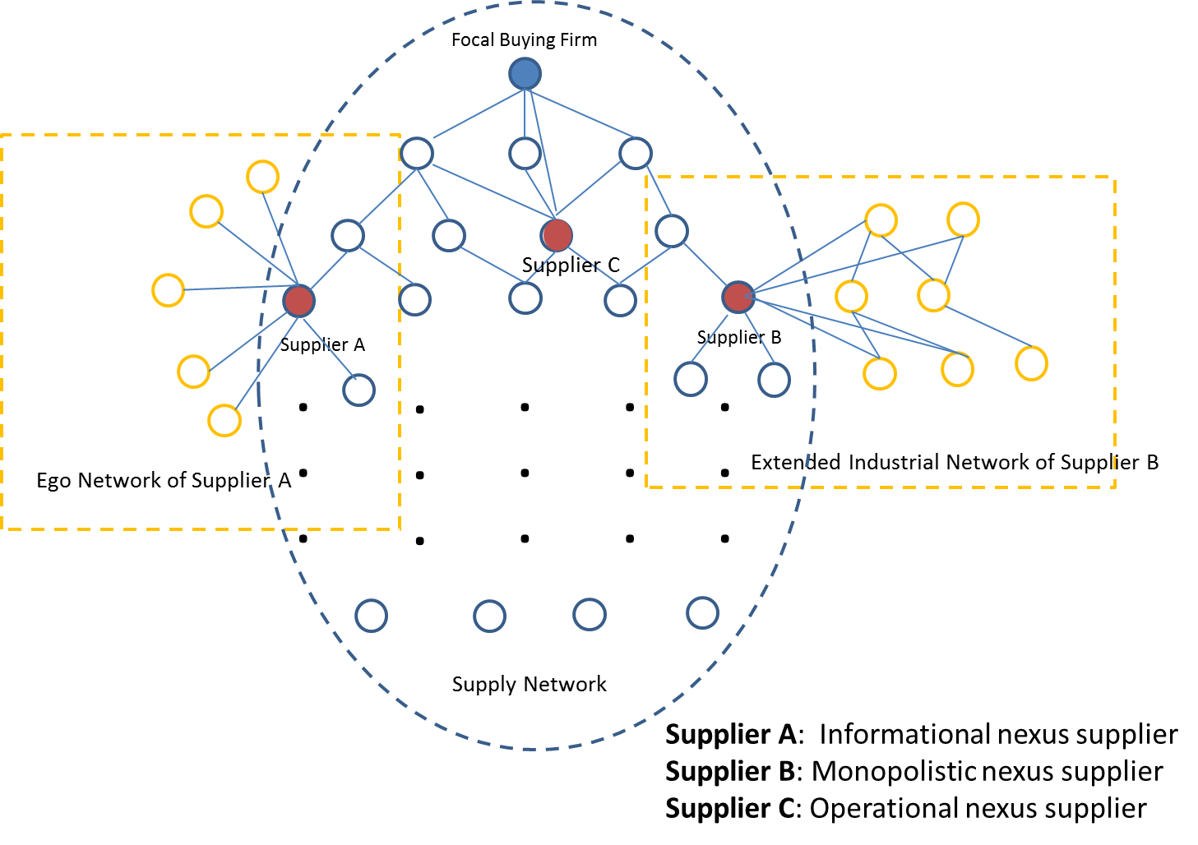
Nexus Suppliers Proposed

Slide 13
Bloomberg SPLC Database
About 28,000 public firms worldwide
Each firm’s suppliers and customers (using information from company filings, industry reports, news articles, etc.)
Value of relationship as a percentage of cost (or revenue)
Firm-level data

Slide 14
Honda’s SN as an Example:
A “Tree-Like” Structure
Total count to fourth tier: 10,832 suppliers
First tier: 245
Second tier: 1,643
Third tier: 4,605
Fourth tier: 4,339

Slide 15
A Tiny Part of the “Network”

Slide 16

The Whole “Network”: Only Three Tiers Deep

Slide 17
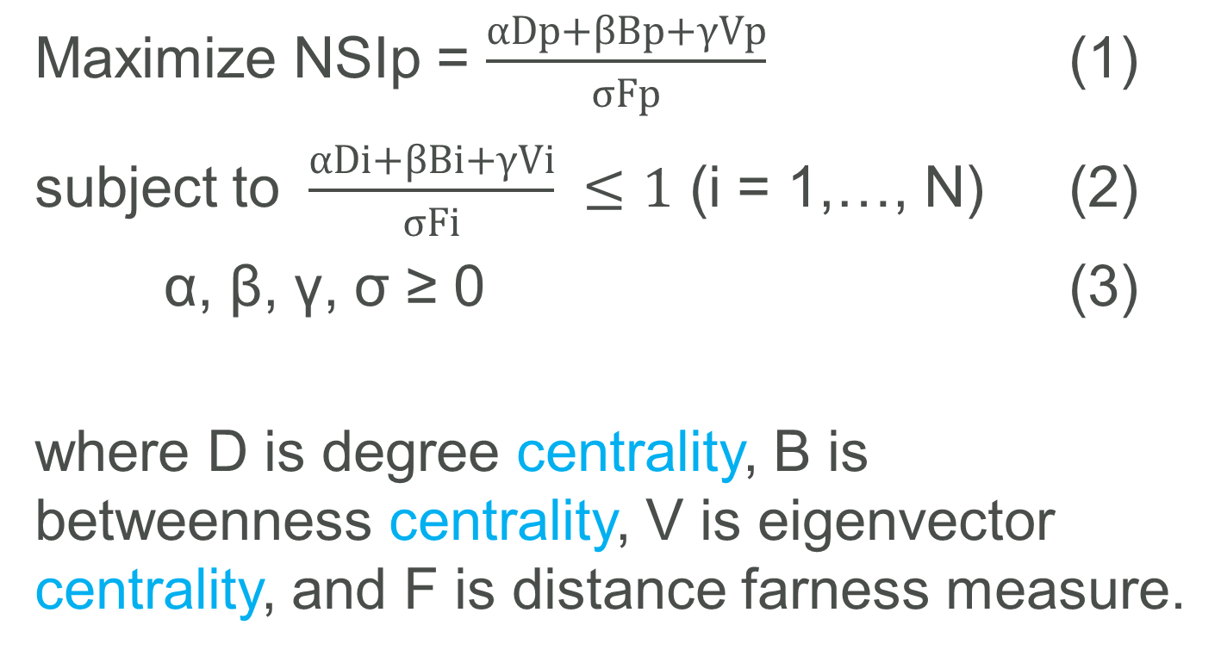
Nexus Supplier Index
Maximize NSIp = $\frac{αDp+βBp+γVp}{σFp}$ (1)
subject to $\frac{αDi+βBi+γVi}{σFi} ≤1$ (i = 1,…, N) (2)
α, β, γ, σ ≥ 0 (3)
where D is degree centrality, B is betweenness centrality, V is eigenvector centrality, and F is distance farness measure.

Slide 18
Top 50 NSI’s from 2nd and 3rd Tiers

Slide 19
Quote from a Honda Manager
“If we can glean one or two or 10 key hints on the list, these might be suppliers we need to dig into more, partner with, mitigate risk with; there is huge value to that.”

Slide 20
Initial Observations
Blind spots
  Monitor
  A small contract and introduction to other suppliers
  Supplier development
VW in the second tier
Apple in the third tier

Slide 21
Focus Studies Topics at CAPS Research

Slide 22
Cloud-Services Outsourcing
Nexus Supplier Index
Supply Chain Financing
Establishing and Achieving Cost Savings Targets
Assessing Supplier’s Innovation Potential
Predictive Business Intelligence

Slide 23
Any questions or comments?

Slide 24
Thank you!!

